Slide 1
DermalScan – AI-Powered Facial Aging Detection System
Deep Learning For Skin ageing and Skin age analysis
Name: Siddhesh Bhatt
Mentor:SpringBoard Mentor781j|Infosys springboard virtual internship6.0

Slide 2
The Need for Intelligent Skin Aging Analysis
01
02
03
04
Existing solutions are either cosmetic gimmicks or costly medical setups. DermalScan bridges that gap with AI.
Manual assessment of facial aging is subjective and time-consuming.
Dermatologists and skincare professionals need quantitative and consistent evaluation.
Consumers want fast, visual insight into how their skin is aging.

Slide 3
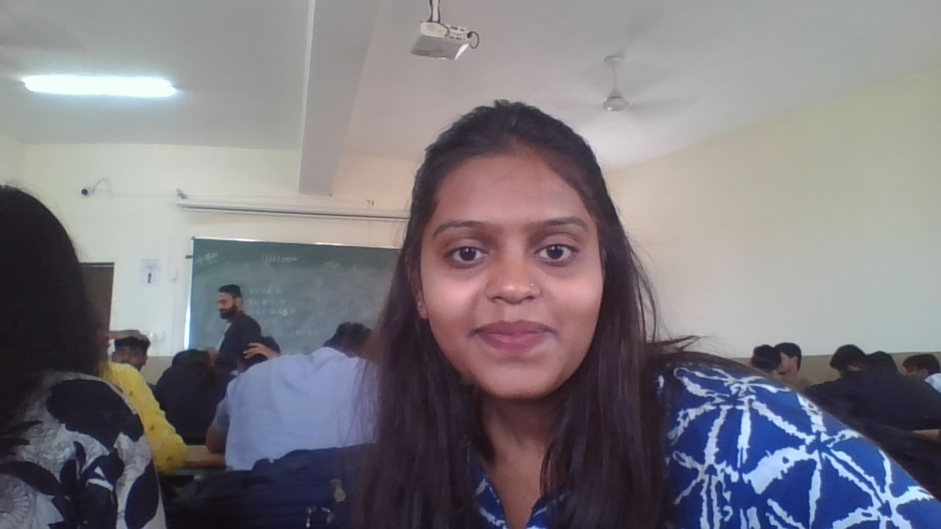
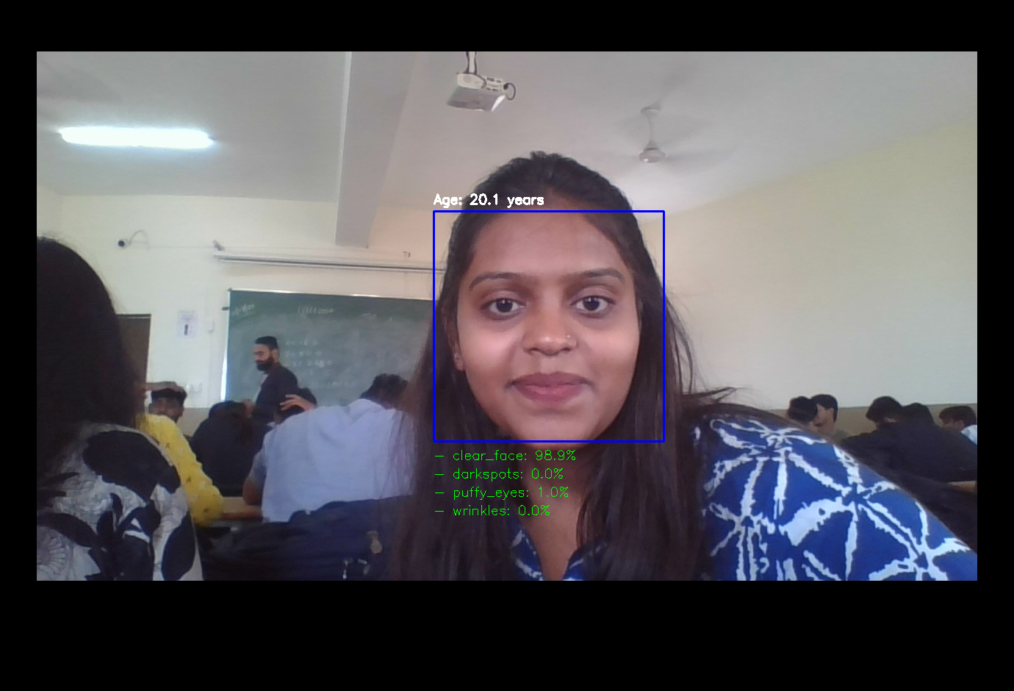
Introducing DermalScan
AI system that detects and classifies visible facial aging signs.
Predicts skin age and quantifies wrinkles, dark spots, and puffy eyes.
Provides annotated visual feedback in seconds via a simple web interface.

Slide 4
What Makes DermalScan Different?
Real-time detection & classification using EfficientNetB0 backbone.
Lightweight design deployable on web & mobile.
High interpretability through annotated images & probability charts.
Modular backend for easy model upgrades.
Built with TensorFlow, OpenCV, and Streamlit.

Slide 5
Under the Hood: End-to-End Pipeline
1.
Image Upload (Frontend)
2.
3.
Face Detection (OpenCV – Haar Cascade)
4.
Preprocessing: crop, resize, normalize
5.
Inference: EfficientNetB0 predicts features + skin age
Display & Download: annotated image + CSV output

Slide 6
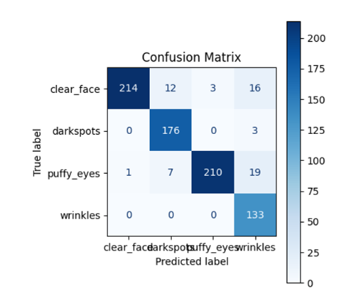
Deep Learning Core
Facial Symptom Model
Dataset: merged open sources + custom-scraped images
Classes: Wrinkles | Dark Spots | Puffy Eyes | Clear Skin: 1K augmented samples per class
Trained with categorical cross-entropy + Adam optimizer
Skin Age Model
Dataset: UTKFace
Age range mapping → normalized continuous labels
Trained using MSE loss~3years, fine-tuned EfficientNetB0 backbone

Slide 7
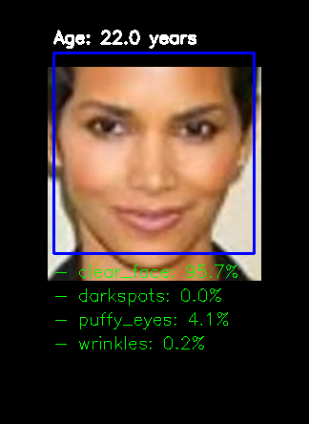
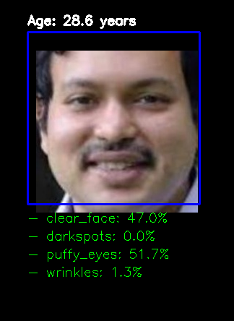
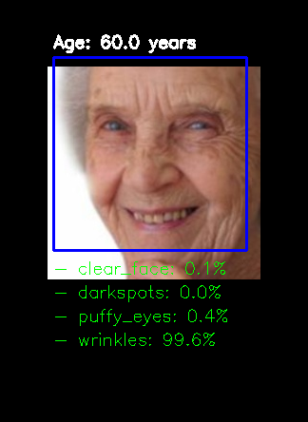
Samples and Examples

Slide 8
Performance Highlights
Classification Accuracy: ~92% on test set
Regression MAE (age prediction): ±3 years
1.
2.
4.
3.
Confusion matrix shows strong separation between classes
Processing and display time less than 5 seconds

Slide 9
What Made It Tough (and Worth It)
Building large, clean datasets from web sources.
Balancing model accuracy vs latency for web deployment.
1.
2.
4.
3.
Managing resource constraints on Colab / cloud environments.
Integrating dual-model inference into one streamlined backend.

Slide 10
Impact & Future Scope
Marketing:
Predicting mass population features to see common skin problems and sell product accordingly
Cosmetics: personalized product recommendations in stores for better customer service
Trust Building: make a game of trying the model 10 days before and after using a product.
Dermatology: early screening tool for aging-related changes. To predict possible diseases

Slide 11
DermalScan in a Line
From research to reality — AI that understands your skin.

Slide 12
THANK YOU

